Slide 2

SE-1515
Stress ECG Workstation
Edan Instruments, Inc.
www.edan.com.cn
info@edan.com.cn
Nov. 27, 2019

Slide 3

Our Position
Top 1 ECG exporter since 2005
All products with CE approval
Most products with US FDA approval
CSE, AHA and MIT certified interpretation

Slide 4


Our R&D Investments
More than 100 R&D engineers
More than 10 years R&D experience
Industrial design associates in Germany

Slide 5

Our Value Proposition
Bring innovation and value together to improve the human health condition.

Slide 6
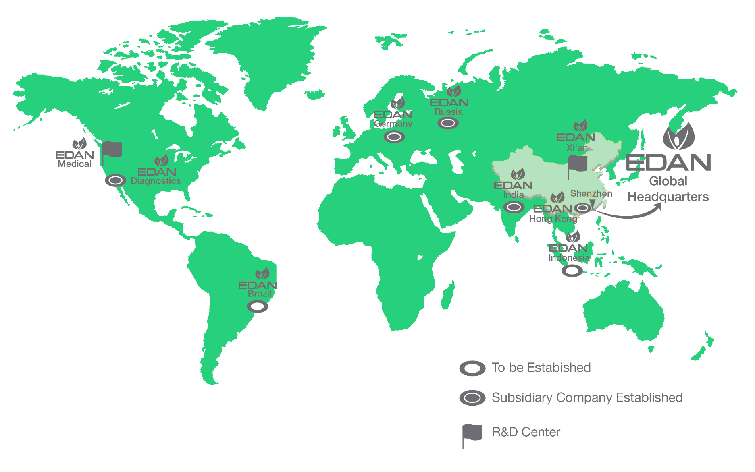

EDAN products has presences in
156 countries

Slide 7
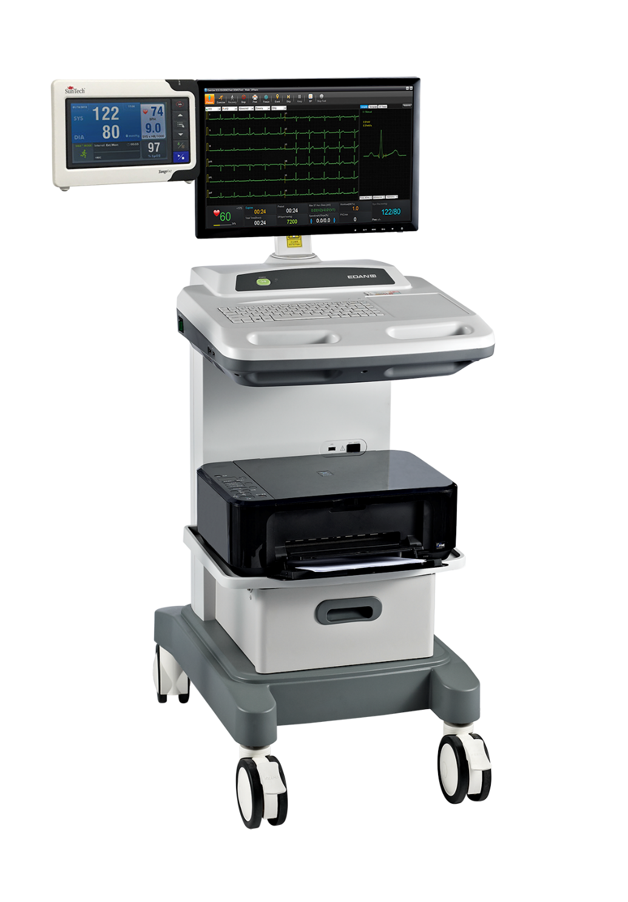
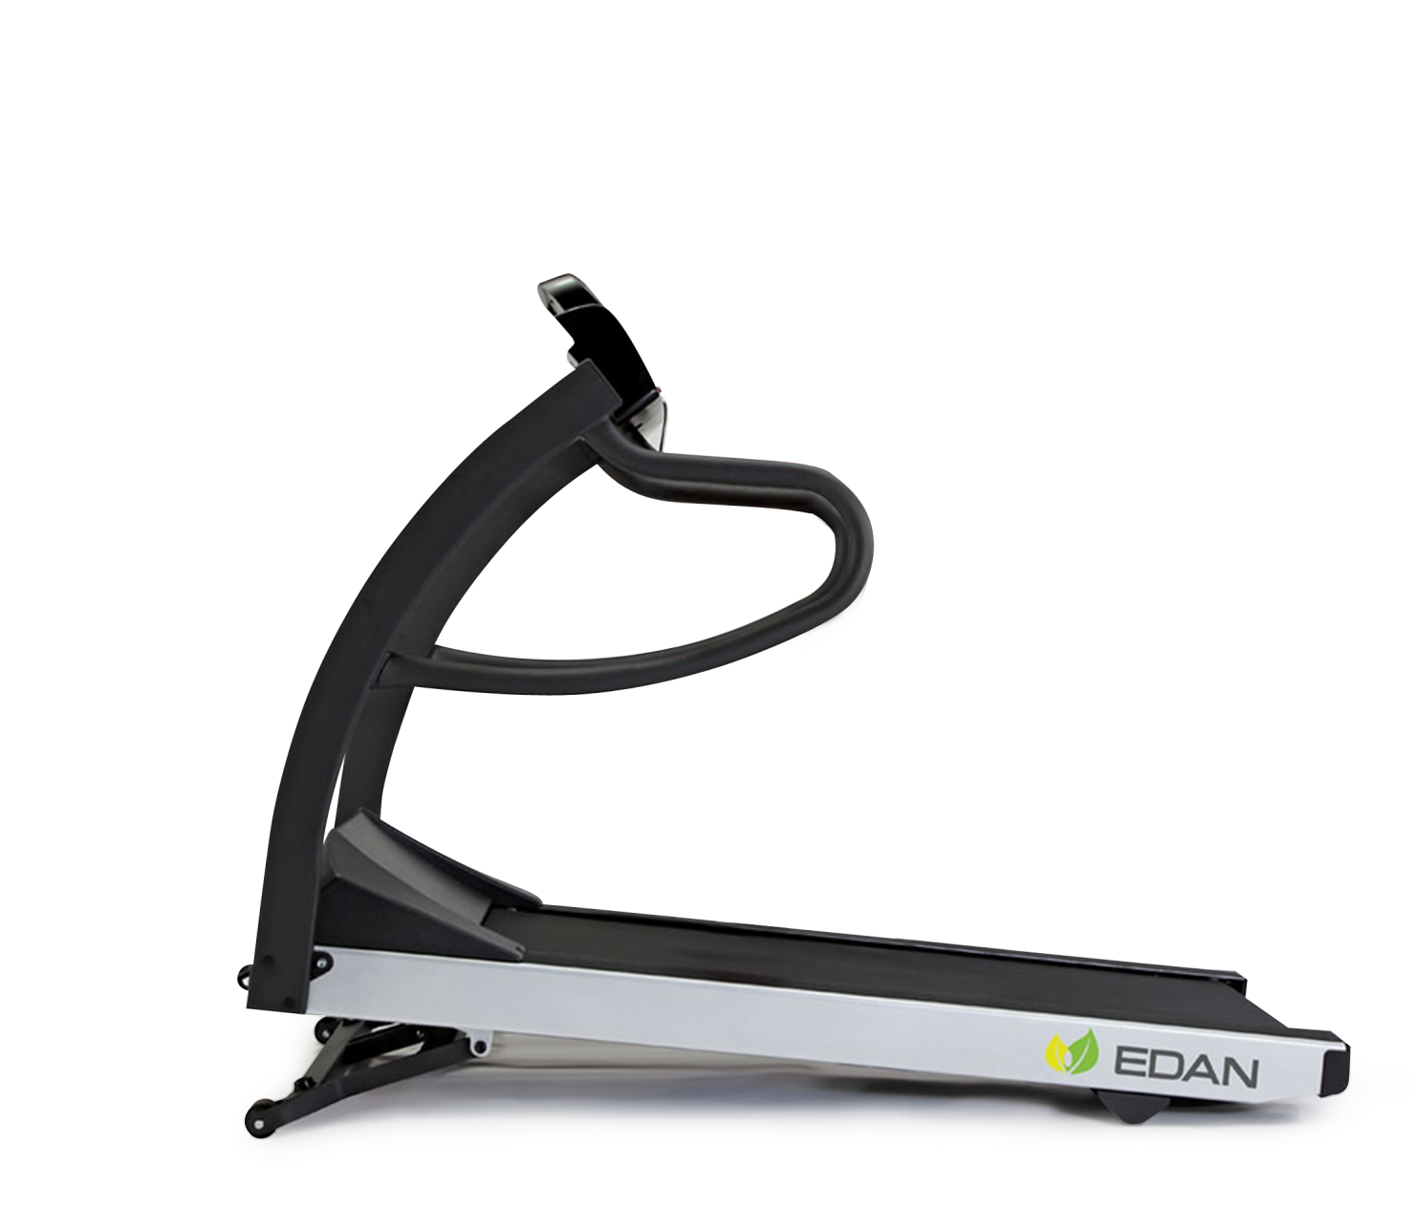
SE-1515
Stress ECG Workstation

Slide 8
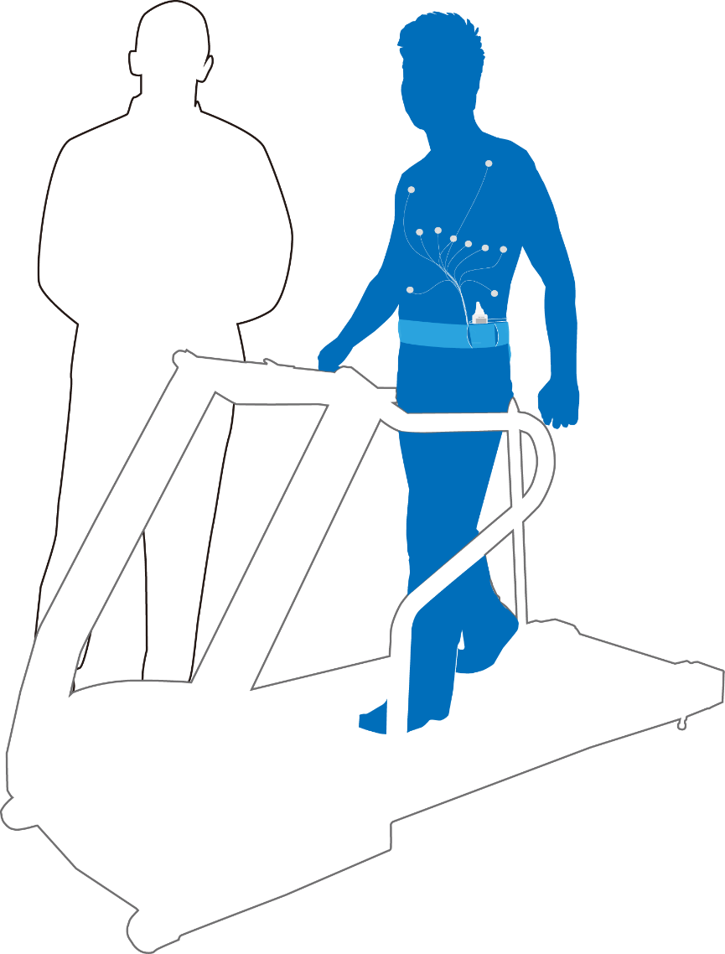
Clinical Background
A cardiac stress test is a test that measures a heart's ability to respond to external stress in a controlled clinical environment. The stress response is induced by exercise or by drug stimulation.
This test can be used to diagnose:
Ischemic heart disease
Assess patient MI prognosis
Physical examination
Rehabilitation

Slide 9
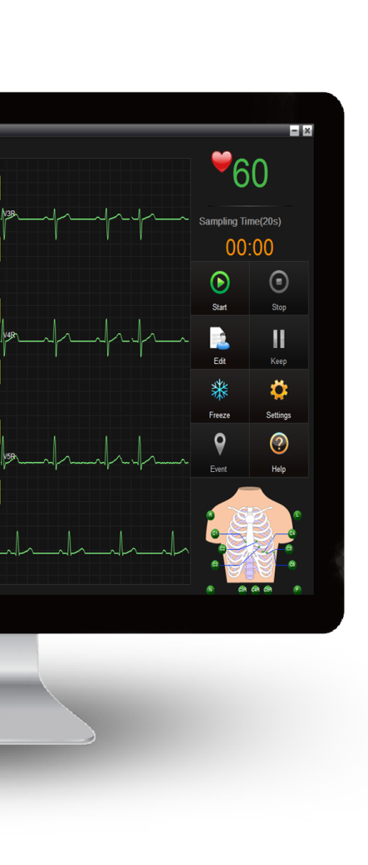
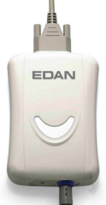
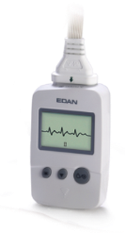
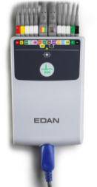
Flexible Configuration
Resting & Stress ECG
Coming
DP12
DX12
DE18
DP12 (support 9/12-lead wired sampling)
DX12 (support 9/12-lead wireless sampling)
DE18 (support 9/12/15/16/18-lead wired sampling)

Slide 10
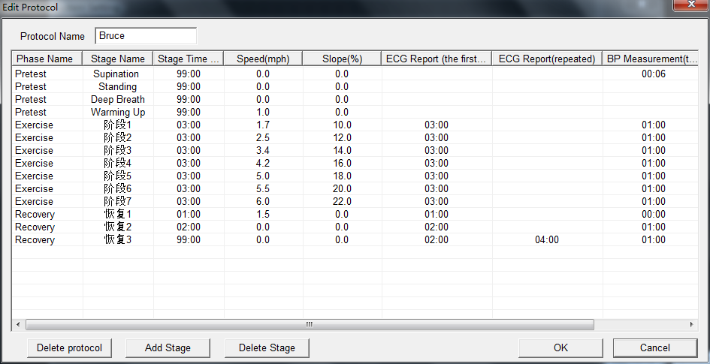
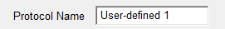
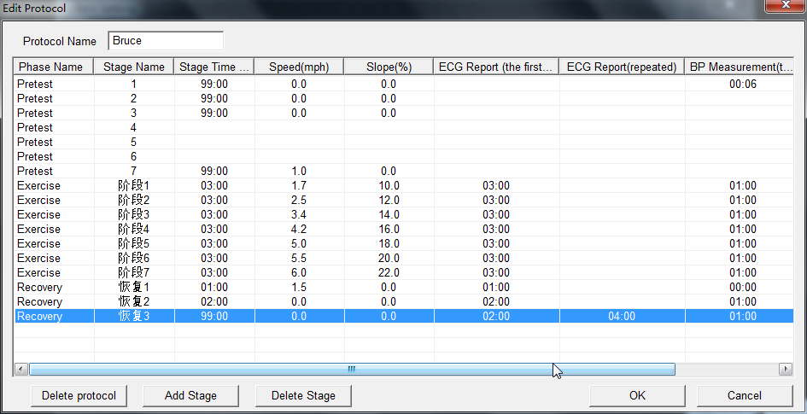
Choose the Right Test
User-defined Protocol
You might choose different workload for different patient, you might need different protocol for different diagnosis. In SE-1515 you can have all you need, you can select the default protocol, or to create user-defined protocol.
User-defined Protocol
In the user-created protocol, you can define different stages with Duration, Speed, Slope.
The time of ECG printing and the time of Blood Pressure measuring can also be set.

Slide 11

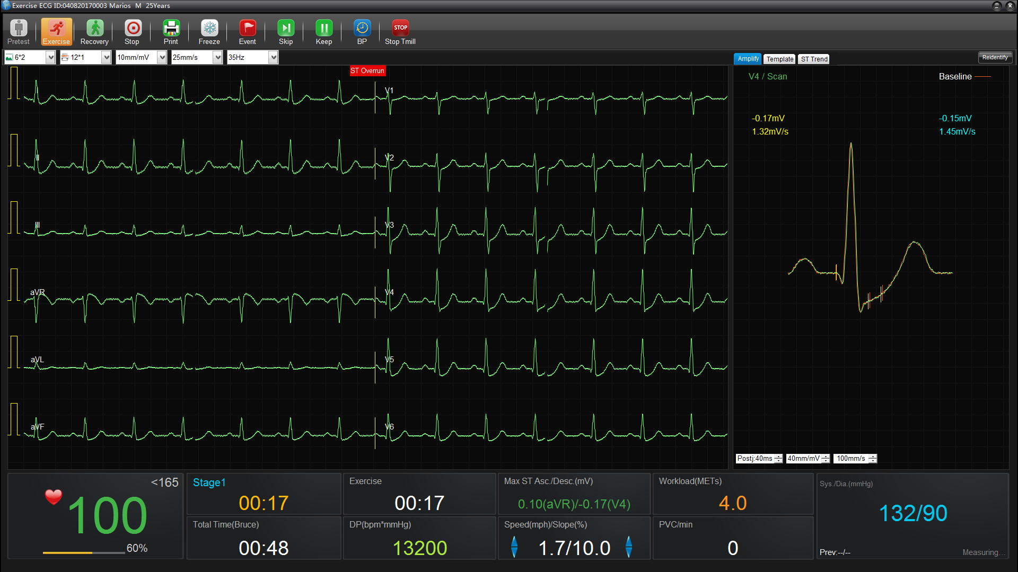
Make Stress Test Efficient
Efficiency in Toolbar
Stress Testing is always with operation on software. SE-1515 provides fast access to frequently-used functions on the top toolbar, so users can finish all the possible operation without leaving the waveform interface.
Easy Toolbar
The main interface brings easy setting on display style and printing style of waveform. You can also change the speed, gain and filter without going to setting menu.
The streamlined workflow is provided at the top toolbar, through which you have fast navigation on Pretest, Exercise, Recovery periods, or ending testing. In Exercise period, you can press Skip to go to next stage or press Keep to prolong the current stage.
The toolbar also provides frequently-used functions including Printing, Freezing, Event, synchronizing Blood Pressure and Stopping treadmill.

Slide 12
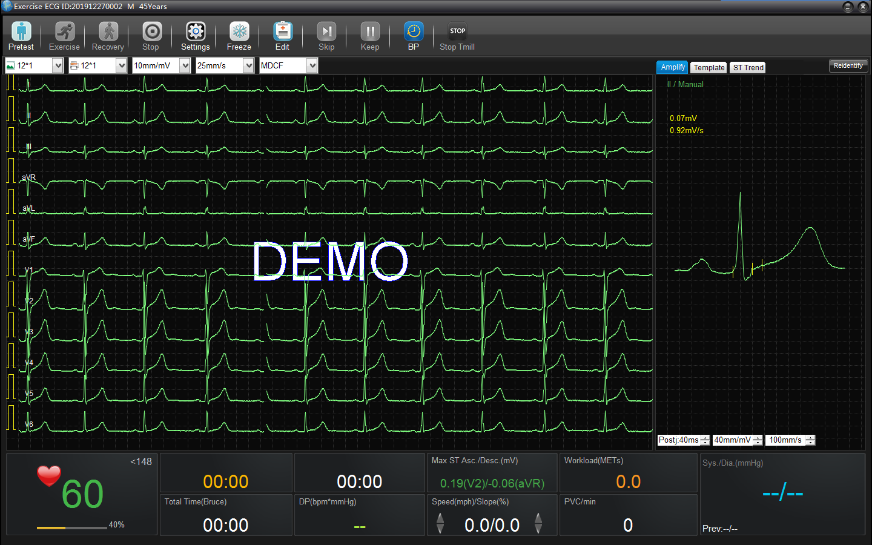
MDCF Filter for Improved Signal Quality
Improved Signal Quality
SE-1515 applies the improved filter technology to ensure clear waveforms in stress test, for instance, the MDCF (Minimum Detectable Continuum Flux) filter is provided to enhance the interference resistance.
MDCF
Filter
10
Templates
CMRR
MDCF filter can be selected directly from filter drop-down menu on main interface.

Slide 13
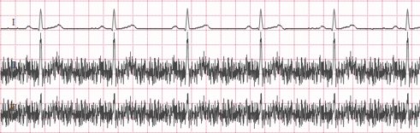
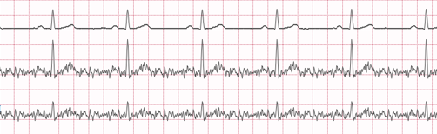
MDCF Filter for Improved Signal Quality
Improved Signal Quality
Once the MDCF filter is applied during the stress ECG test, the EMG noise
will be significantly reduced.
MDCF
Filter
10
Templates
Without
MDCF Filter
With MDCF Filter

Slide 14
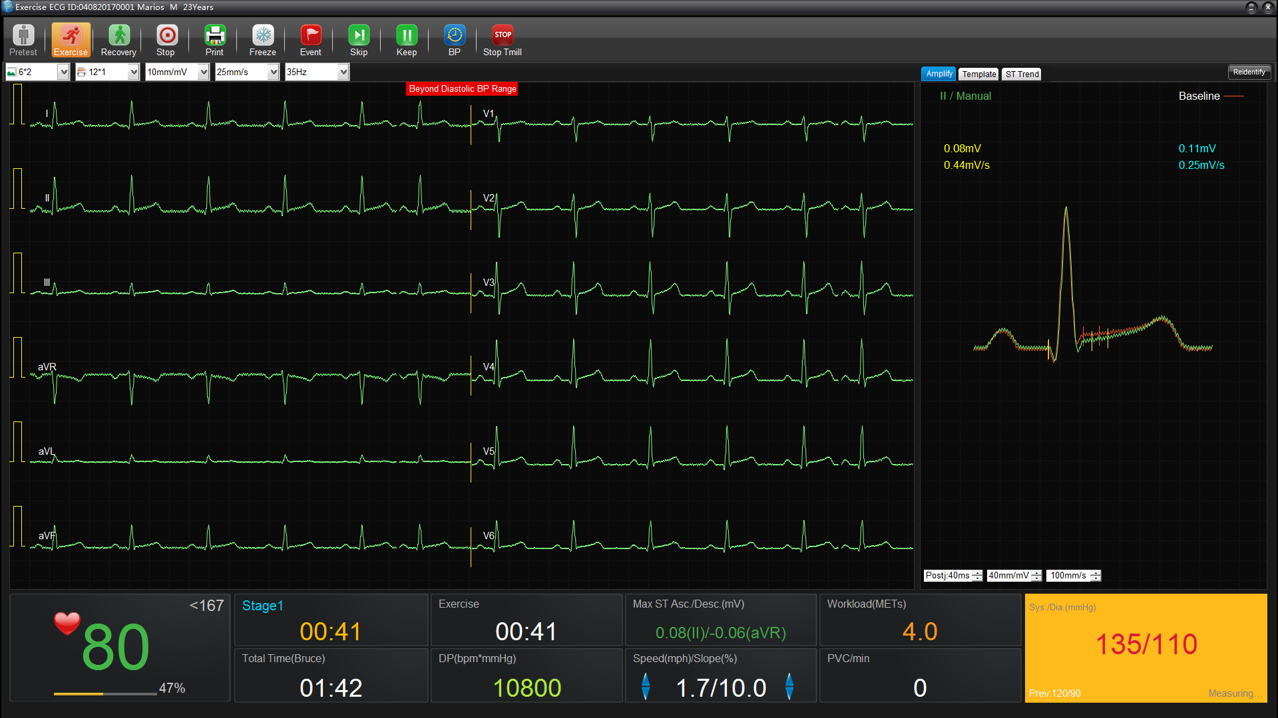
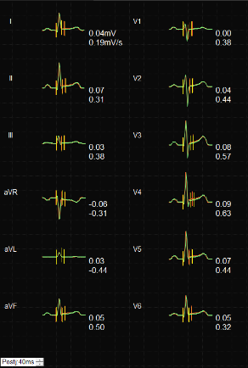
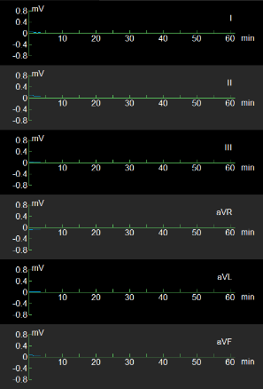
Be Aware of Small Changes
Real-time ST Indication
The ST comparison graph on the right is refreshing in every 10 seconds, displaying in magnified, template or trend mode, through which clinician can easily catch the ST anomalies and morphology changes.
Real-time
ST Indication

Slide 15
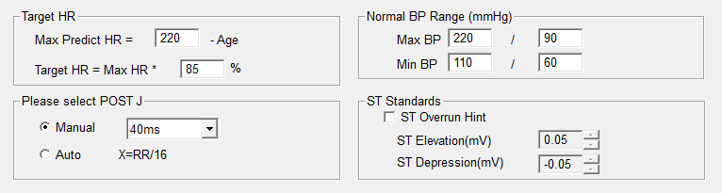
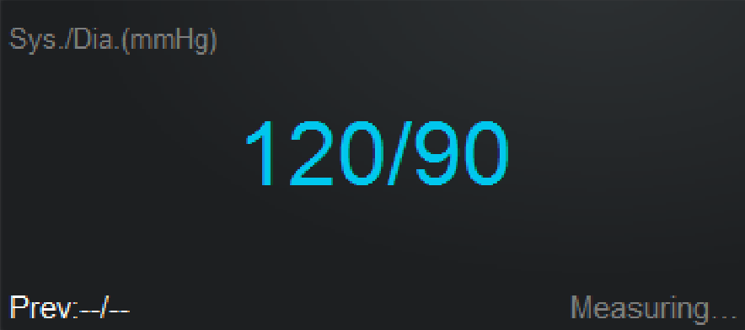
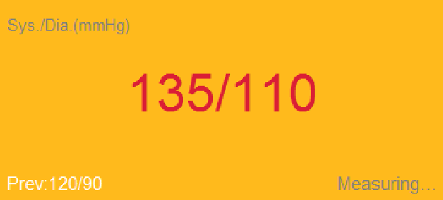
Always Caring Patient
On-screen Hint
Stress test can be dangerous if doctors miss the exceeded Heart Rate, Blood Rate or ST change by accident. To make stress test safer, user can set the alarming range to let SE-1515 give hints when readings beyond the range.
On-screen Hint
BP in normal range
BP beyond range

Slide 16

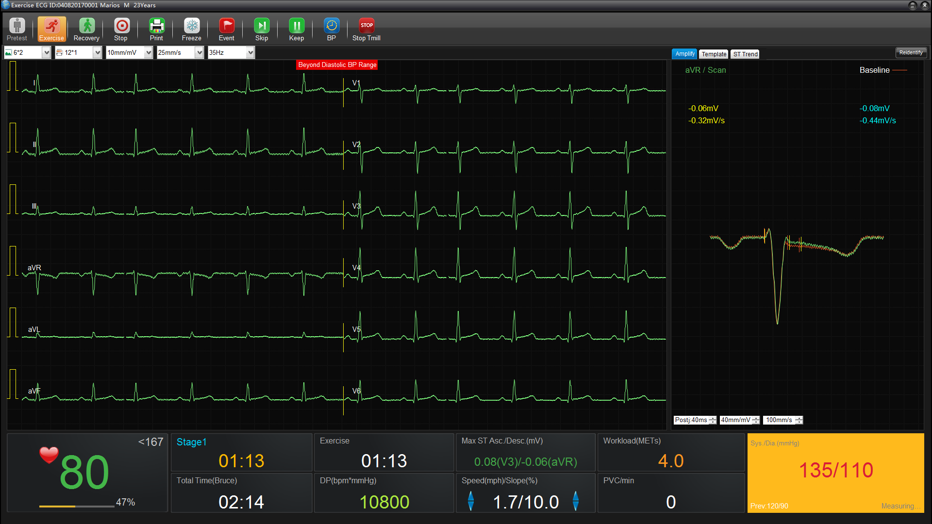
Advanced Clinical Support
Comprehensive evaluation
SE-1515 brings a clear viewing on comprehensive assessments reading of stress test, where clinician can easily watch for ST level changes, Blood Pressure, Heart Rate and Premature Ventricular Contractions.
Comprehensive Evaluation
The main interface of Stress ECG shows core readings of concerning parameters. It shows current HR, target HR and an intuitive progress bar of percentage of the target HR, giving a clear presenting on stress intensity.
Another reading that matters is the Max ST elevation and depression. SE-1515 shows the value of ST change and the corresponding channels.
Further more, the software calculates the Premature Ventricular Contractions in every minute, so clinicians can estimate the workload and the heart condition of patient.

Slide 17
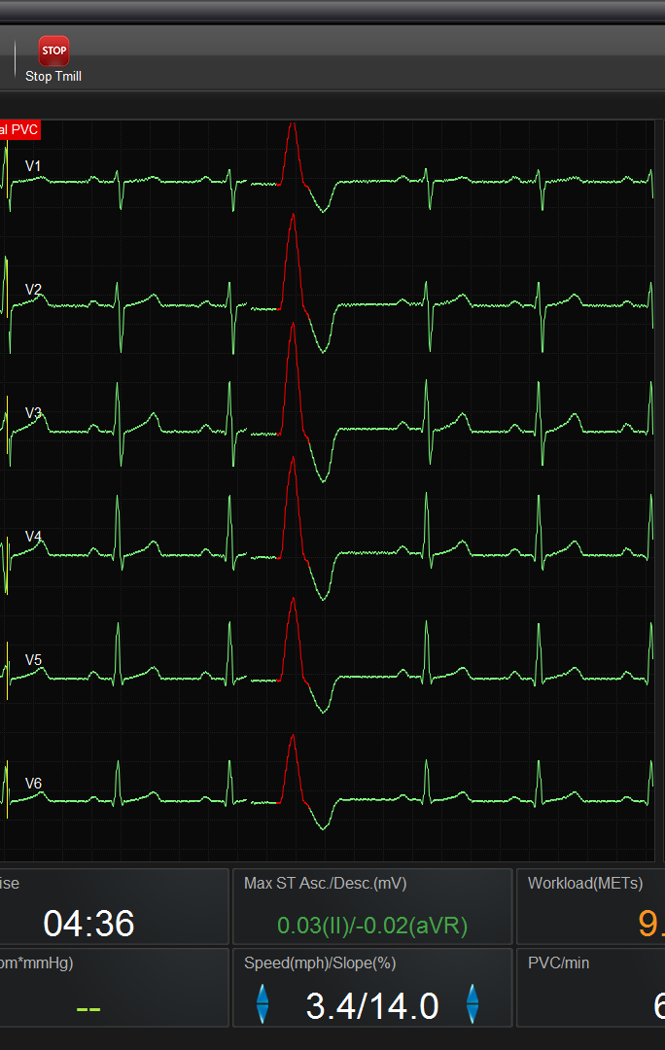
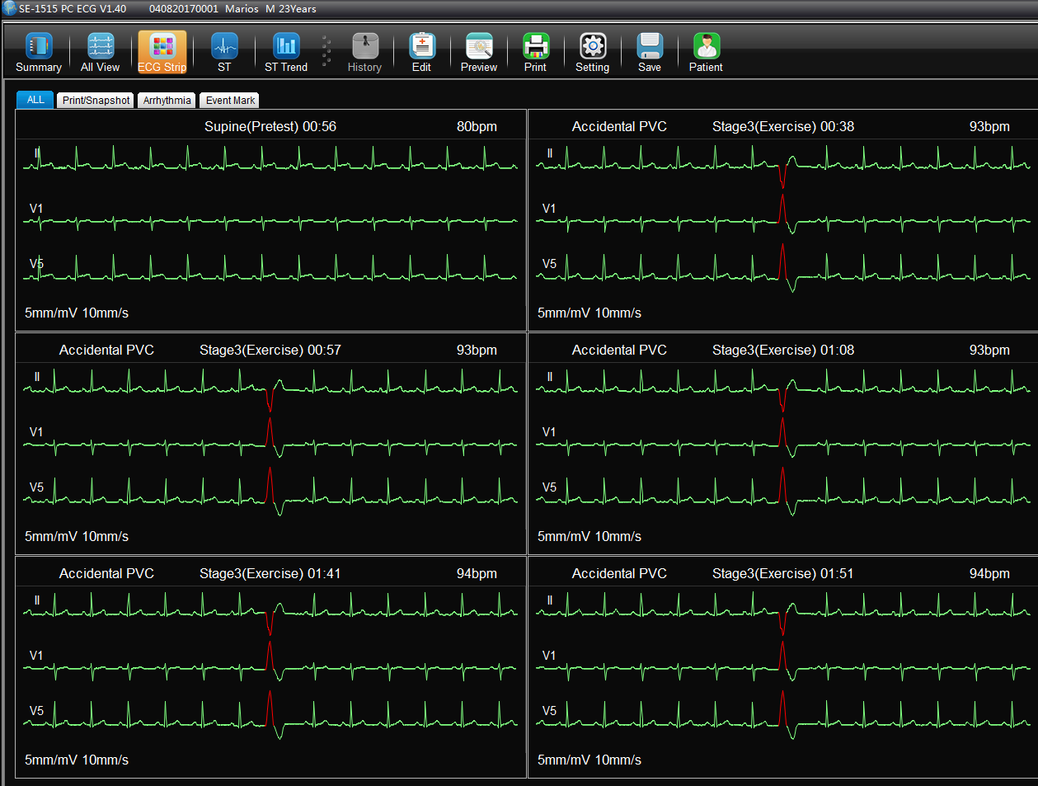

Never Miss the Arrhythmia
Arrhythmia
Highlight
Automatic Highlight Arrhythmia
The waveforms with arrhythmia will be highlighted as red, which is obviously distinguishable. When arrhythmia is detected, waveforms can be automatically saved for further analyzing.
10
Templates

Slide 18
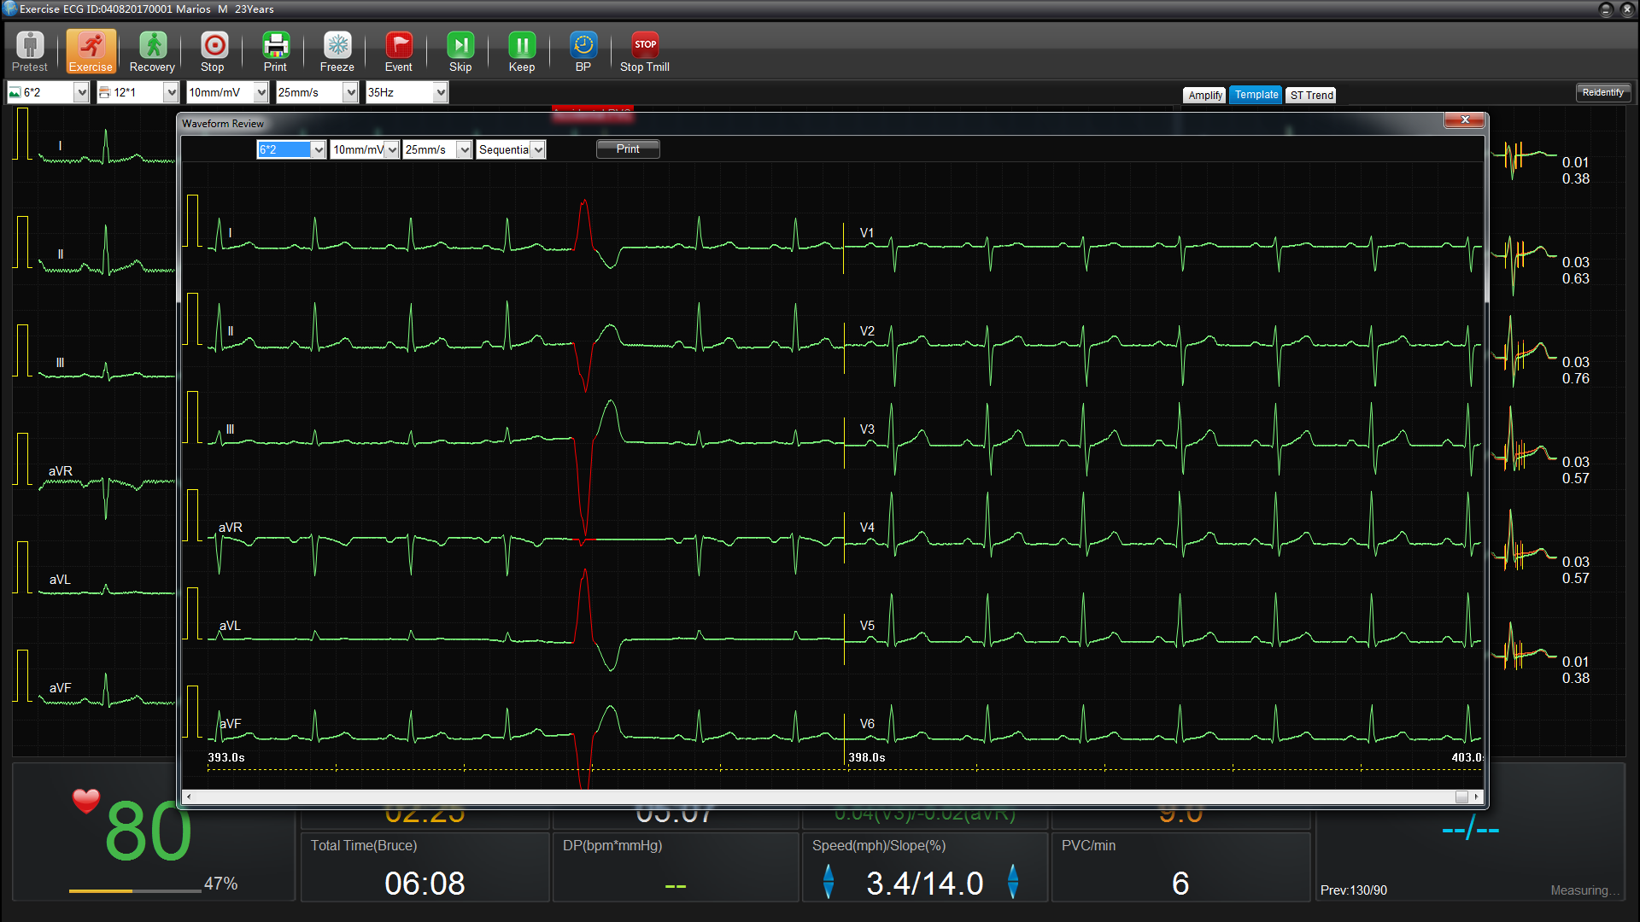
Print the Report in Time
Freezing and Reviewing
Without disrupting the current sampling, the freezing function allows clinicians to review the waveform, and to choose any segment to print.
Freezing
Notes:
<此页为PPT页面切换过渡页>

Slide 19
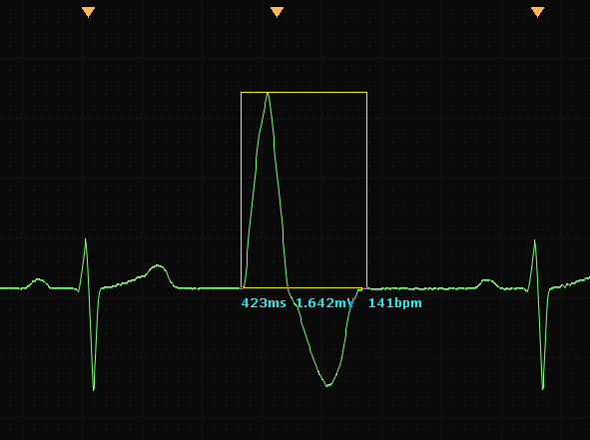
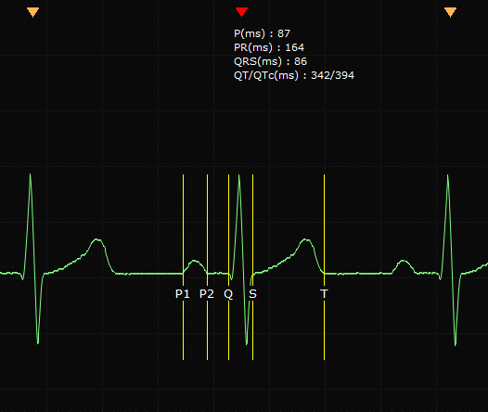
Always Catch the Detail
On-screen Measurement
By double clicking the waveform, clinician can magnify any segment of the waveform and measure it on-screen. In addition, Clinicians can manually modify the position of a marker line and update the measurement on ECG report with one click.
On-screen
Measuring
Notes:
<此页为PPT页面切换过渡页>

Slide 20
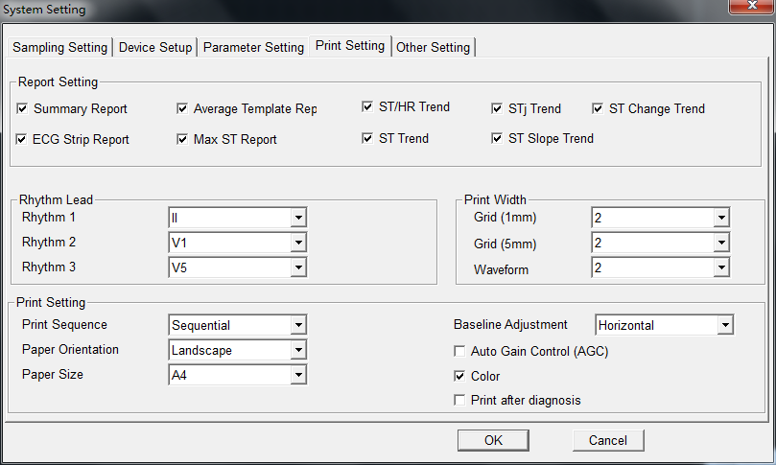
Diagnose with Confidence
Customizable Report
SE-1515 Stress ECG system supports comprehensive and selectable report, so that clinicians can choose the appropriate chapters on printing.
Customizable Report
Users can select the structure of report, including Summary, Average Template, ST/HR Trend, STj Trend, ST Change Trend, ECG Strips, Max ST, ST Trend and ST Slope Trend. With these information, clinicians can tell not only general cardiac evaluation, but also find ST deviations in space and in time.
Notes:
<此页为PPT页面切换过渡页>

Slide 21
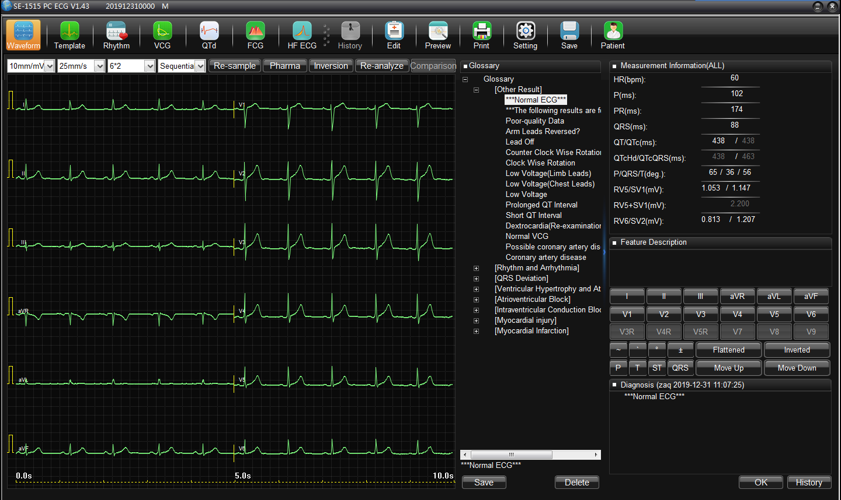
Write the Report Faster
Built-in ECG glossary
The built-in ECG glossary consists of rich diagnostic templates with detail feature descriptions and integrated diagnostic results, which helps clinicians draw conclusion effectively and efficiently.
Glossary
Build-in
Glossary
Notes:
<此页为PPT页面切换过渡页>

Slide 22
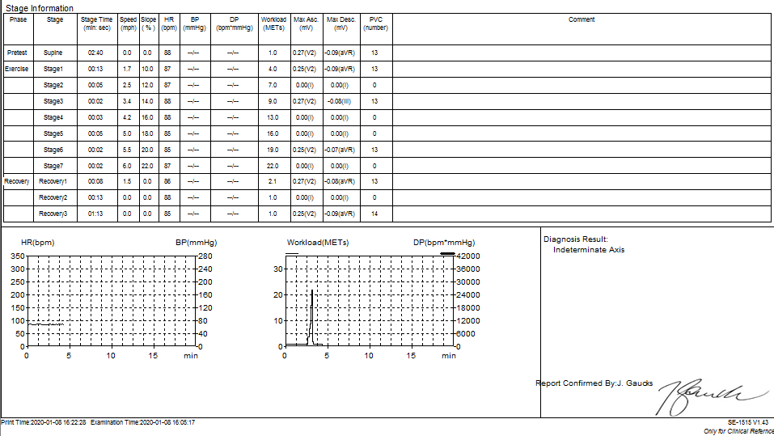
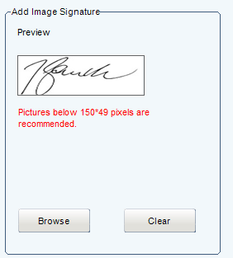
Design Your E-signature
Personalized Signature
User can upload the specific signature to have it on resting report, stress ECG report and Holter report after confirm the ECG report.
Personalized
Signature
CMRR
Notes:
<此页为PPT页面切换过渡页>

Slide 23
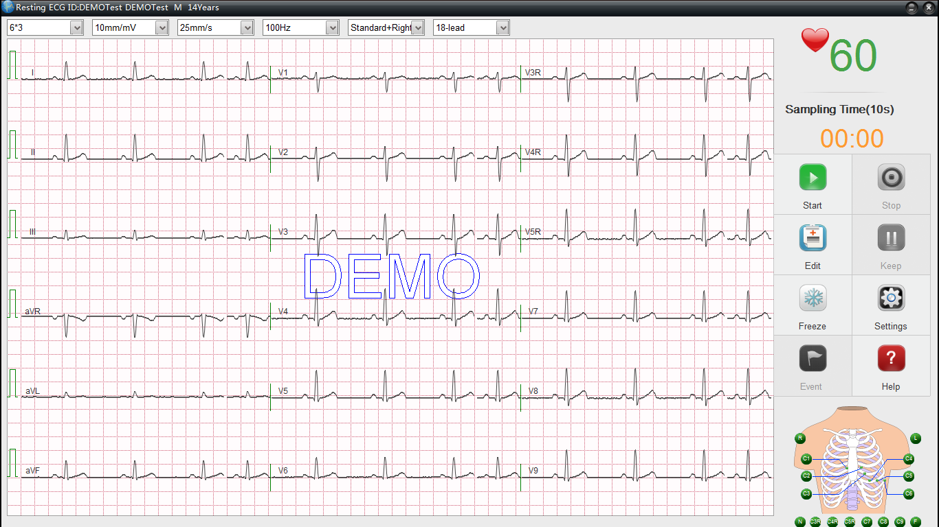
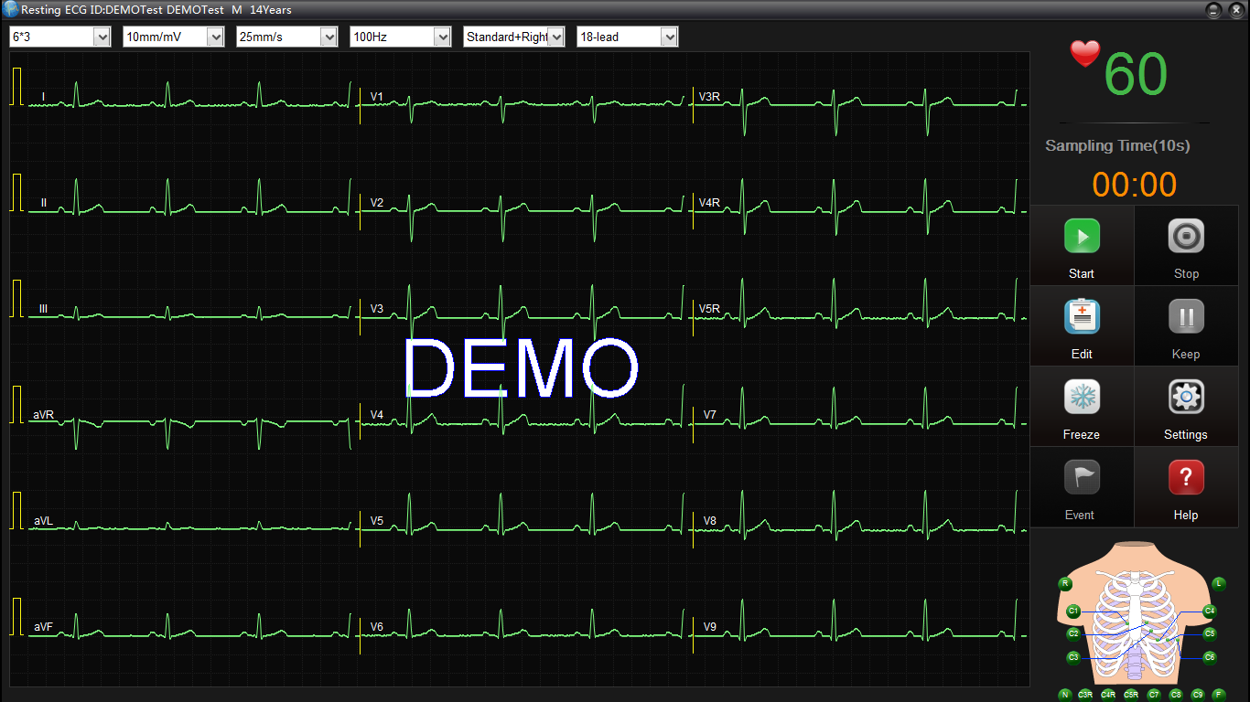
Choose the Interface You Like
1
Selectable Display Style
To improve user experience, SE-1515 ECG Software offers two display style : Bright and Classical, fitting for different users’ habit.
Bright
2
Selectable
Display style
Bright Display Style
Classical Display Style

Slide 24
THANK YOU
Edan Instruments, Inc.
www.edan.com.cn
Info@edan.com.cn
Nov. 27, 2019

